Slide 1
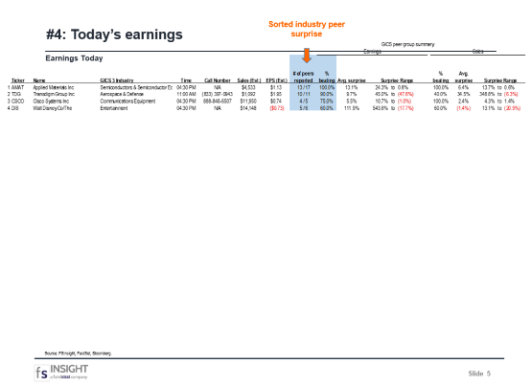
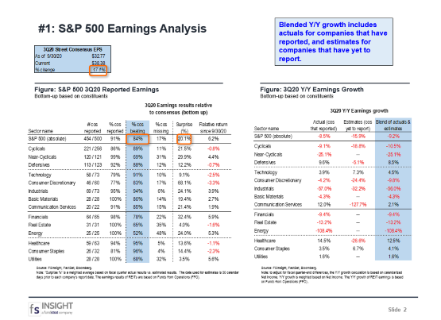
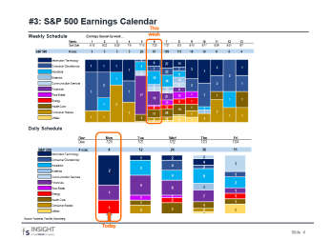
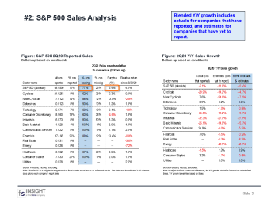
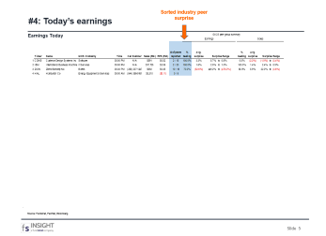
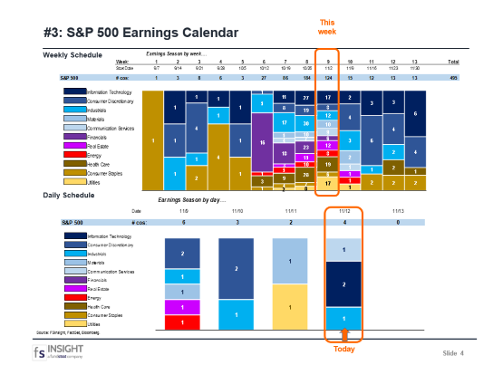
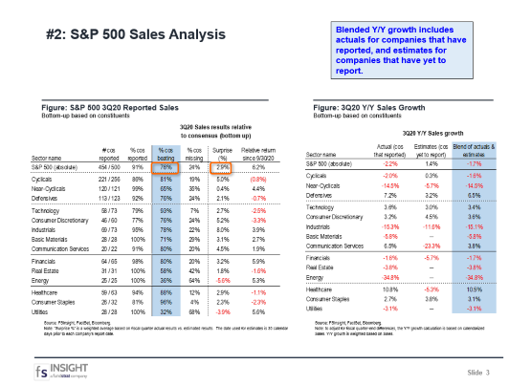
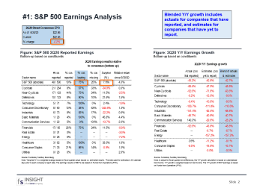
FSInsight
Daily
Earnings
Update
S&P 500 3Q20 Earnings Analysis
S&P 500 3Q20 Sales Analysis
Date: 10/19/18
S&P 500 Earnings Calendar
Today’s Earnings
11/12/20
For Reg AC certification and other important disclosures, see Disclosures, Slide 11.

Slide 2
#1: S&P 500 Earnings Analysis
Blended Y/Y growth includes actuals for companies that have reported, and estimates for companies that have yet to report.
Figure: S&P 500 3Q20 Reported Earnings
Bottom-up based on constituents
Figure: 3Q20 Y/Y Earnings Growth
Bottom-up based on constituents
Source: FSInsight, FactSet, Bloomberg.
Note: "Surprise %" is a weighted average based on fiscal quarter actual results vs. estimated results. The date used for estimates is 30 calendar days prior to each company's report date. The earnings results of REITs are based on Funds from Operations (FFO).
Source: FSInsight, FactSet, Bloomberg.
Note: to adjust for fiscal quarter-end differences, the Y/Y growth calculation is based on calendarized Net Income. Y/Y growth is weighted based on Net Income. The Y/Y growth of REIT earnings is based on Funds from Operations (FFO)..

Slide 3
#2: S&P 500 Sales Analysis
Blended Y/Y growth includes actuals for companies that have reported, and estimates for companies that have yet to report.
Figure: S&P 500 3Q20 Reported Sales
Bottom-up based on constituents
Figure: 3Q20 Y/Y Sales Growth
Bottom-up based on constituents
Source: FSInsight, FactSet, Bloomberg.
Note: "Surprise %" is a weighted average based on fiscal quarter actual results vs. estimated results. The date used for estimates is 30 calendar days prior to each company's report date.
Source: FSInsight, FactSet, Bloomberg.
Note: to adjust for fiscal quarter-end differences, the Y/Y growth calculation is based on calendarized Sales. Y/Y growth is weighted based on Sales.

Slide 4
#3: S&P 500 Earnings Calendar
This week
Weekly Schedule
Daily Schedule
Source: FSInsight, FactSet, Bloomberg.
Today

Slide 5
#4: Today’s earnings
Sorted industry peer surprise
Earnings Today
Source: FSInsight, FactSet, Bloomberg.

Slide 6
Sorted by
#5: SALES BEATS over the last week
Figure: Companies beating top-line estimates
Sorted based on magnitude of sales beat
Source: FSInsight, FactSet, Bloomberg.
(1) Compares the actual reported result to the consensus estimate. The date used for estimates is 30 calendar days prior to the company’s report date.

Slide 7
Sorted by
#5a: SALES MISSES over the last week
Figure: Companies missing top-line estimates
Sorted based on magnitude of sales miss
Source: FSInsight, FactSet, Bloomberg.
(1) Compares the actual reported result to the consensus estimate. The date used for estimates is 30 calendar days prior to the company’s report date.

Slide 8
Sorted by
#6: EPS BEATS over the last week
Figure: Companies beating bottom-line estimates
Sorted based on magnitude of EPS beat
Source: FSInsight, FactSet, Bloomberg.
(1) Compares the actual reported result to the consensus estimate. The date used for estimates is 30 calendar days prior to the company’s report date.

Slide 9
Sorted by
#6a: EPS MISSES over the last week
Figure: Companies missing bottom-line estimates
Sorted based on magnitude of EPS beat
Source: FSInsight, FactSet, Bloomberg.
(1) Compares the actual reported result to the consensus estimate. The date used for estimates is 30 calendar days prior to the company’s report date.

Slide 10
Sorted by
#7: EBIT MARGIN BEATS over the last week
Figure: Companies beating margin estimates
Sorted based on magnitude of EBIT margin beat
Source: FSInsight, FactSet, Bloomberg.
(1) Compares the actual reported result to the consensus estimate. The date used for estimates is 30 calendar days prior to the company’s report date.

Slide 11
Disclosures
This research is for the clients of FS Insight only. For additional information, please contact us via phone at +1-212-293-7140 or via email at inquiry@fsinsight.com.
Conflicts of Interest
This research contains the views, opinions and recommendations of FS Insight. At the time of publication of this report, FS Insight does not know of, or have reason to know of any material conflicts of interest.
General Disclosures
FS Insight is an independent research company and is not a registered investment advisor and is not acting as a broker dealer under any federal or state securities laws.
FS Insight is a member of IRC Securities’ Research Prime Services Platform. IRC Securities is a FINRA registered broker-dealer that is focused on supporting the independent research industry. Certain personnel of FS Insight (i.e. Research Analysts) are registered representatives of IRC Securities, a FINRA member firm registered as a broker-dealer with the Securities and Exchange Commission and certain state securities regulators. As registered representatives and independent contractors of IRC Securities, such personnel may receive commissions paid to or shared with IRC Securities for transactions placed by FS Insight clients directly with IRC Securities or with securities firms that may share commissions with IRC Securities in accordance with applicable SEC and FINRA requirements. IRC Securities does not distribute the research of FS Insight , which is available to select institutional clients that have engaged FS Insight .
As registered representatives of IRC Securities our analysts must follow IRC Securities’ Written Supervisory Procedures. Notable compliance policies include (1) prohibition of insider trading or the facilitation thereof, (2) maintaining client confidentiality, (3) archival of electronic communications, and (4) appropriate use of electronic communications, amongst other compliance related policies.
FS Insight does not have the same conflicts that traditional sell-side research organizations have because FS Insight (1) does not conduct any investment banking activities, (2) does not manage any investment funds, and (3) our clients are only institutional investors.
This research is for the clients of FS Insight only. Additional information is available upon request. Information has been obtained from sources believed to be reliable but FS Insight does not warrant its completeness or accuracy except with respect to any disclosures relative to FS Insight and the analyst's involvement (if any) with any of the subject companies of the research. All pricing is as of the market close for the securities discussed, unless otherwise stated. Opinions and estimates constitute our judgment as of the date of this material and are subject to change without notice. Past performance is not indicative of future results. This material is not intended as an offer or solicitation for the purchase or sale of any financial instrument. The opinions and recommendations herein do not take into account individual client circumstances, risk tolerance, objectives, or needs and are not intended as recommendations of particular securities, financial instruments or strategies. The recipient of this report must make its own independent decision regarding any securities or financial instruments mentioned herein. Except in circumstances where FS Insight expressly agrees otherwise in writing, FS Insight is not acting as a municipal advisor and the opinions or views contained herein are not intended to be, and do not constitute, advice, including within the meaning of Section 15B of the Securities Exchange Act of 1934. All research reports are disseminated and available to all clients simultaneously through electronic publication to our internal client website, FS Insight .com. Not all research content is redistributed to our clients or made available to third-party aggregators or the media. Please contact your sales representative if you would like to receive any of our research publications.
Copyright 2020 FS Insight LLC. All rights reserved. No part of this material may be reprinted, sold or redistributed without the prior written consent of FS Insight LLC.

